Slide 1


From Early Modern Printing to Post-Modern Indie Publishing
Using eMOP on AFP
Jennifer Hecker [@lasuprema]
  austinfanzineproject.org/
Matthew Christy [@matt_christy]
  emop.tamu.edu/
&

Slide 2
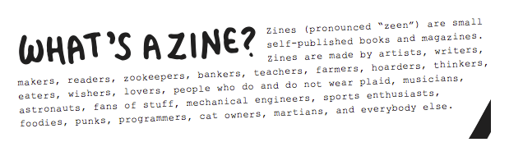
Fanzine? Zine?
“A magazine produced
for love, not money.”
- I didn’t make this up, but I have no idea who said it first

Slide 3
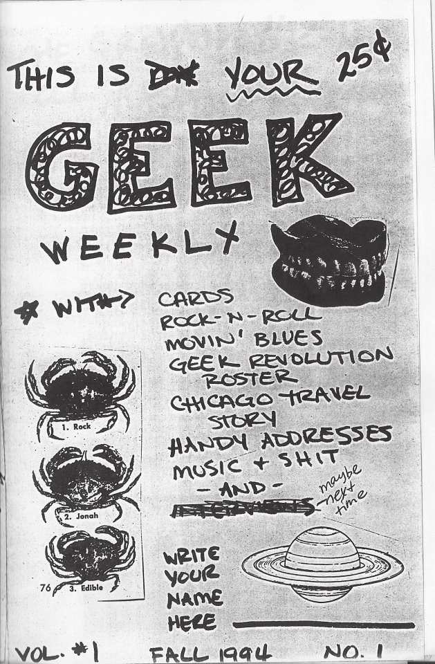




Background

Slide 4
Original Concept
    Austin Fanzine Digitization, Transcription & Indexing Project
    Access-focused
    DIY Digitization & online submissions
    Creator/community-sourced transcription

Slide 5
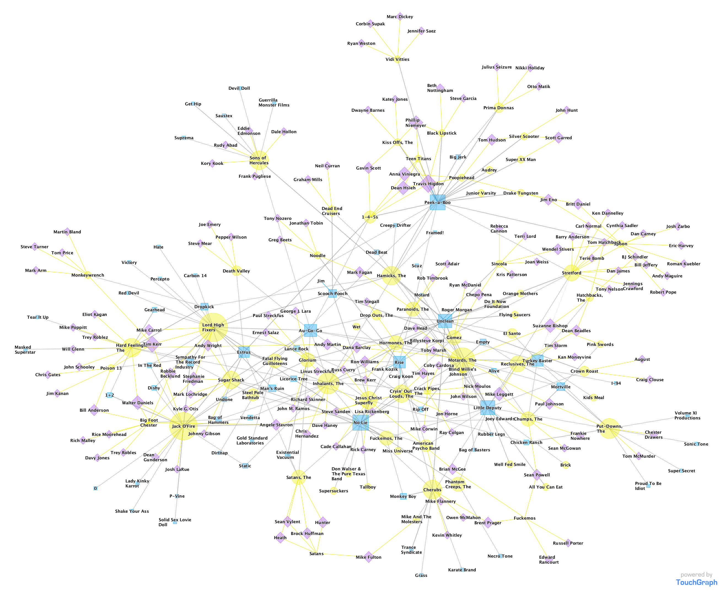
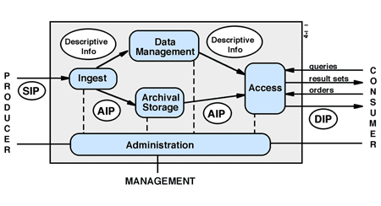
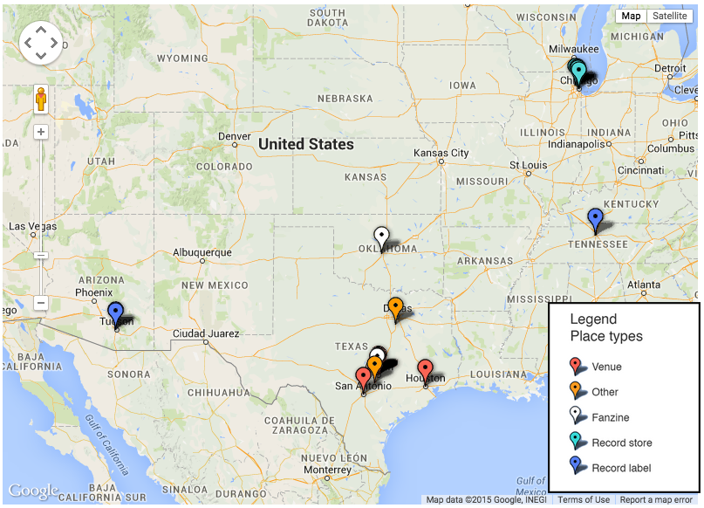


Evolution into DH Sandbox
Kevin Powell
Spring 2013
Kate Neptune
Summer 2014
Kristin Bongiovanni
Spring 2014

Slide 6
Transcription Issues
Inconsistent layout (columns, offset text, text-wrapped around other text)
Inconsistent humans (style-guides and subject knowledge help)
Images

Slide 7
eMOP – Intro
The Early Modern OCR Project (eMOP) is an
  Andrew W. Mellon Foundation funded grant project running out of the Initiative for Digital Humanities, Media, and Culture (IDHMC) at Texas A&M University, to
  develop and test tools and techniques to apply Optical Character Recognition (OCR) to early modern English documents
  from the hand press period, roughly 1475-1800.
eMOP aims to improve the visibility of early modern texts by making their contents fully searchable. The current paradigm of searching special collections for early modern materials by either metadata alone or “dirty” OCR is insufficient for scholarly research.

Slide 8
eMOP – The Numbers
Page Images
GroundTruth
Early English Books online (Proquest) EEBO: ~125,000 documents, ~13 million pages images (1475-1700)
Eighteenth Century Collections Online (Gale Cengage) ECCO: ~182,000 documents, ~32 million page images (1700-1800)
Total: >300,000 documents & 45 million page images.
Text Creation Partnership TCP: ~46,000 double-keyed hand transcribed docuemnts
  44,000 EEBO
  2,200 ECCO

Slide 9
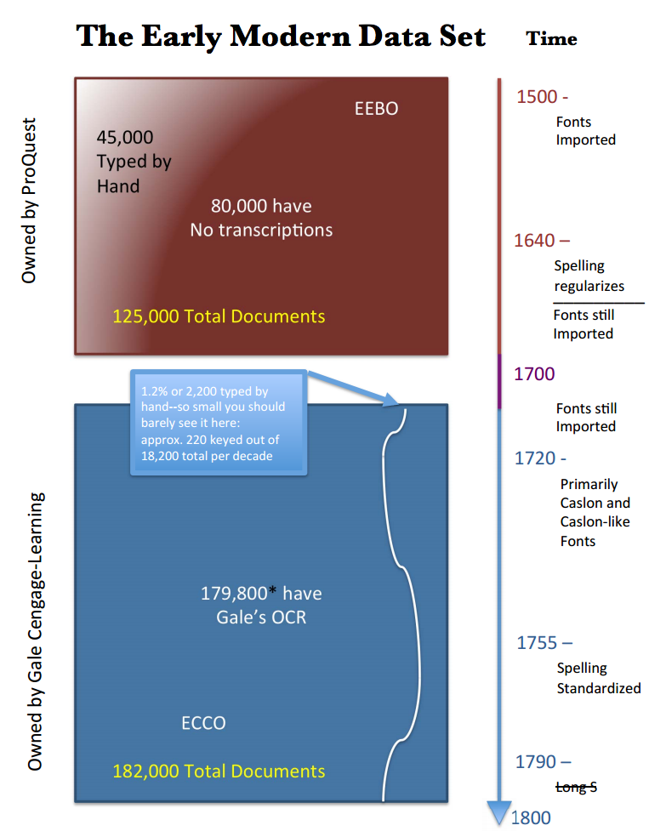
eMOP – The Data

Slide 10
eMOP – The Problems
Early Modern Printing
  Individual, hand-made typefaces
  Worn and broken type
  Poor quality equipment/paper
  Inconsistent line bases
  Unusual page layouts, decorative page elements,
  Special characters & ligatures
  Spelling variations
  Mixed typefaces and languages
  over/under-inking
Digitization
  Old, low-quality, small tiff files
  Noise, skew, warp, bleedthrough

Slide 11
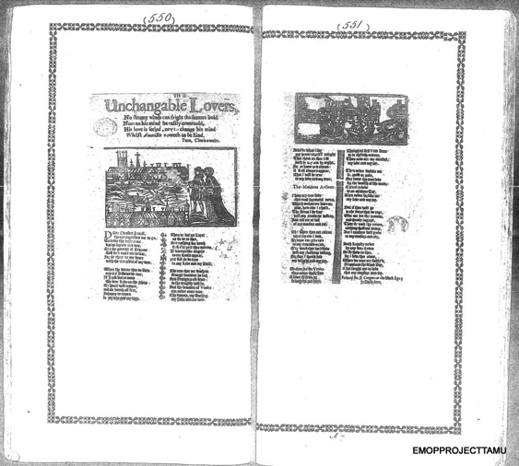
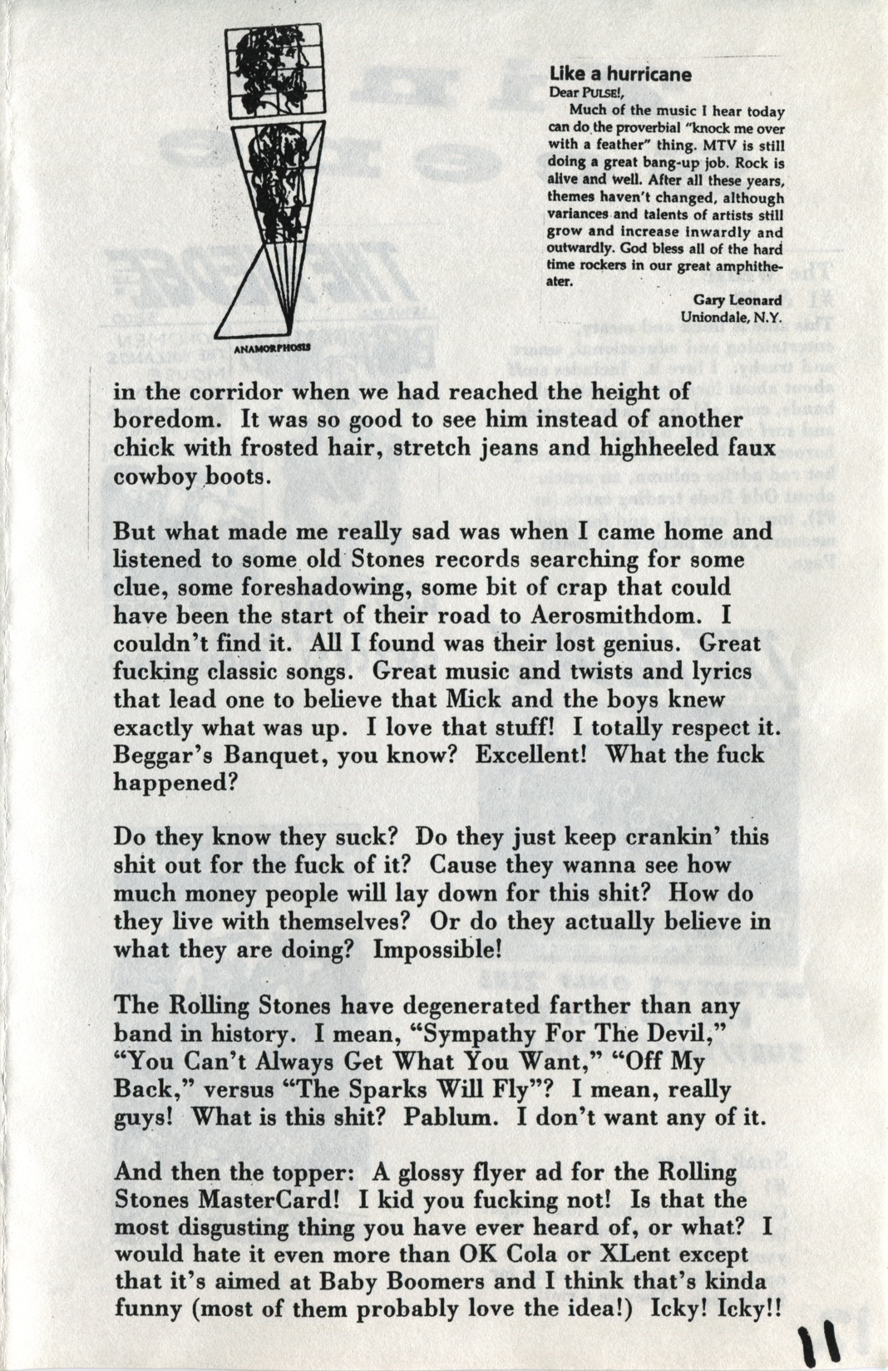
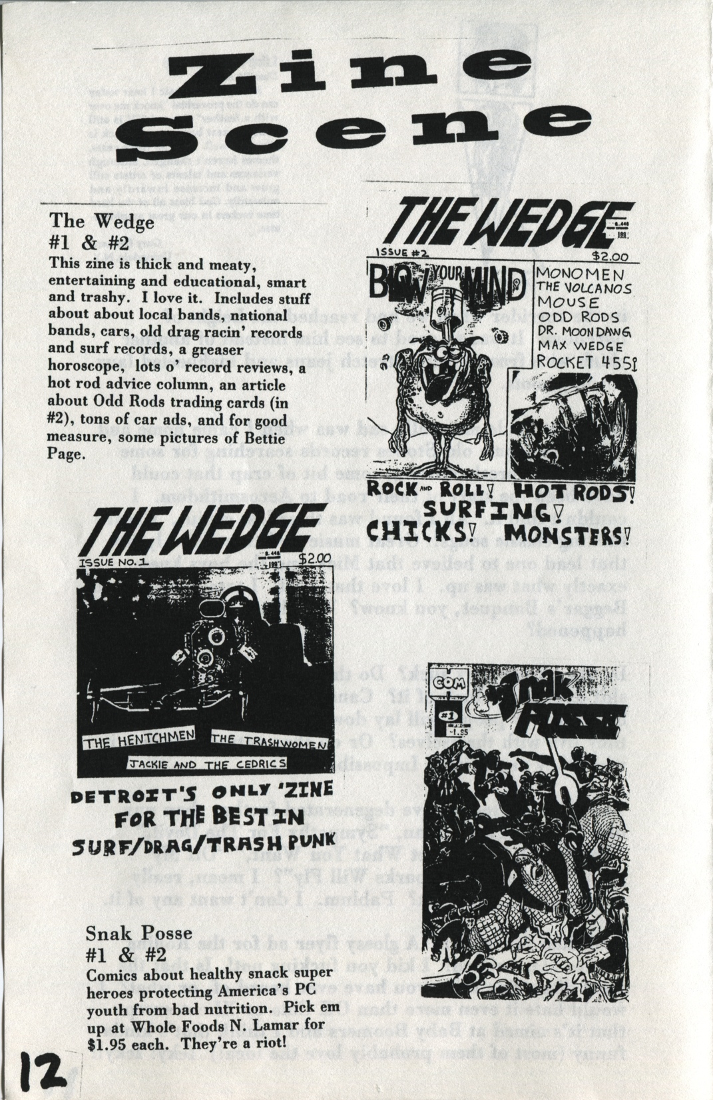
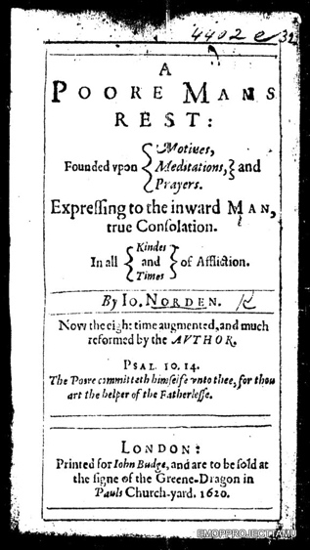
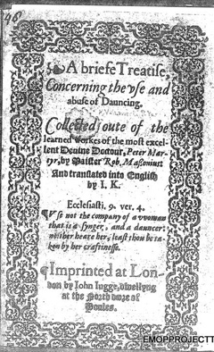
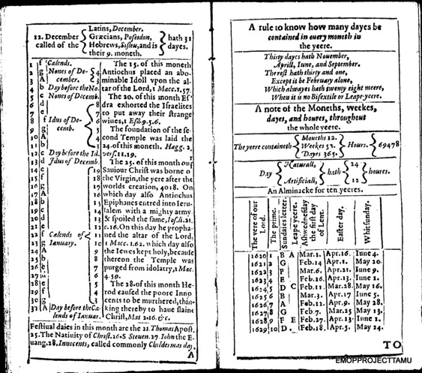
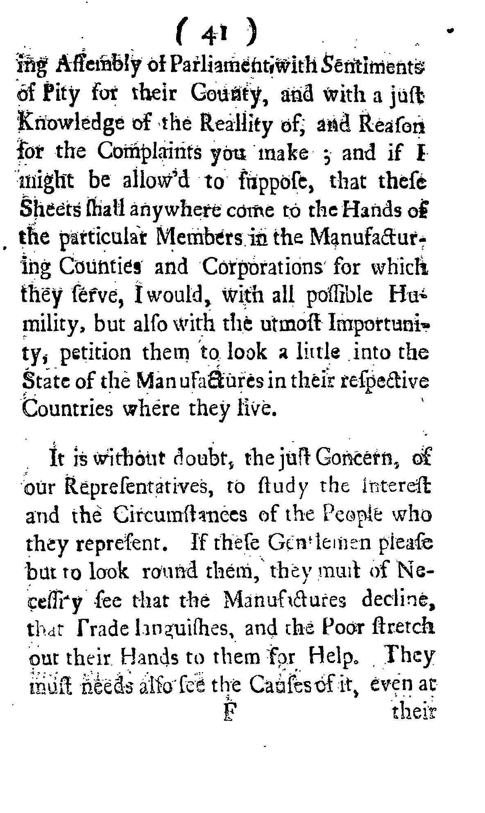
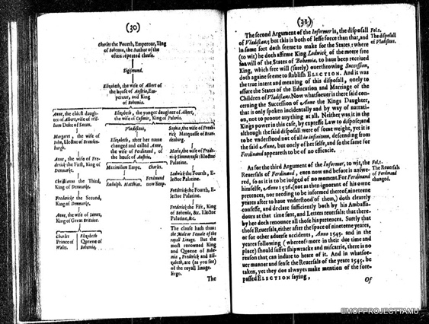
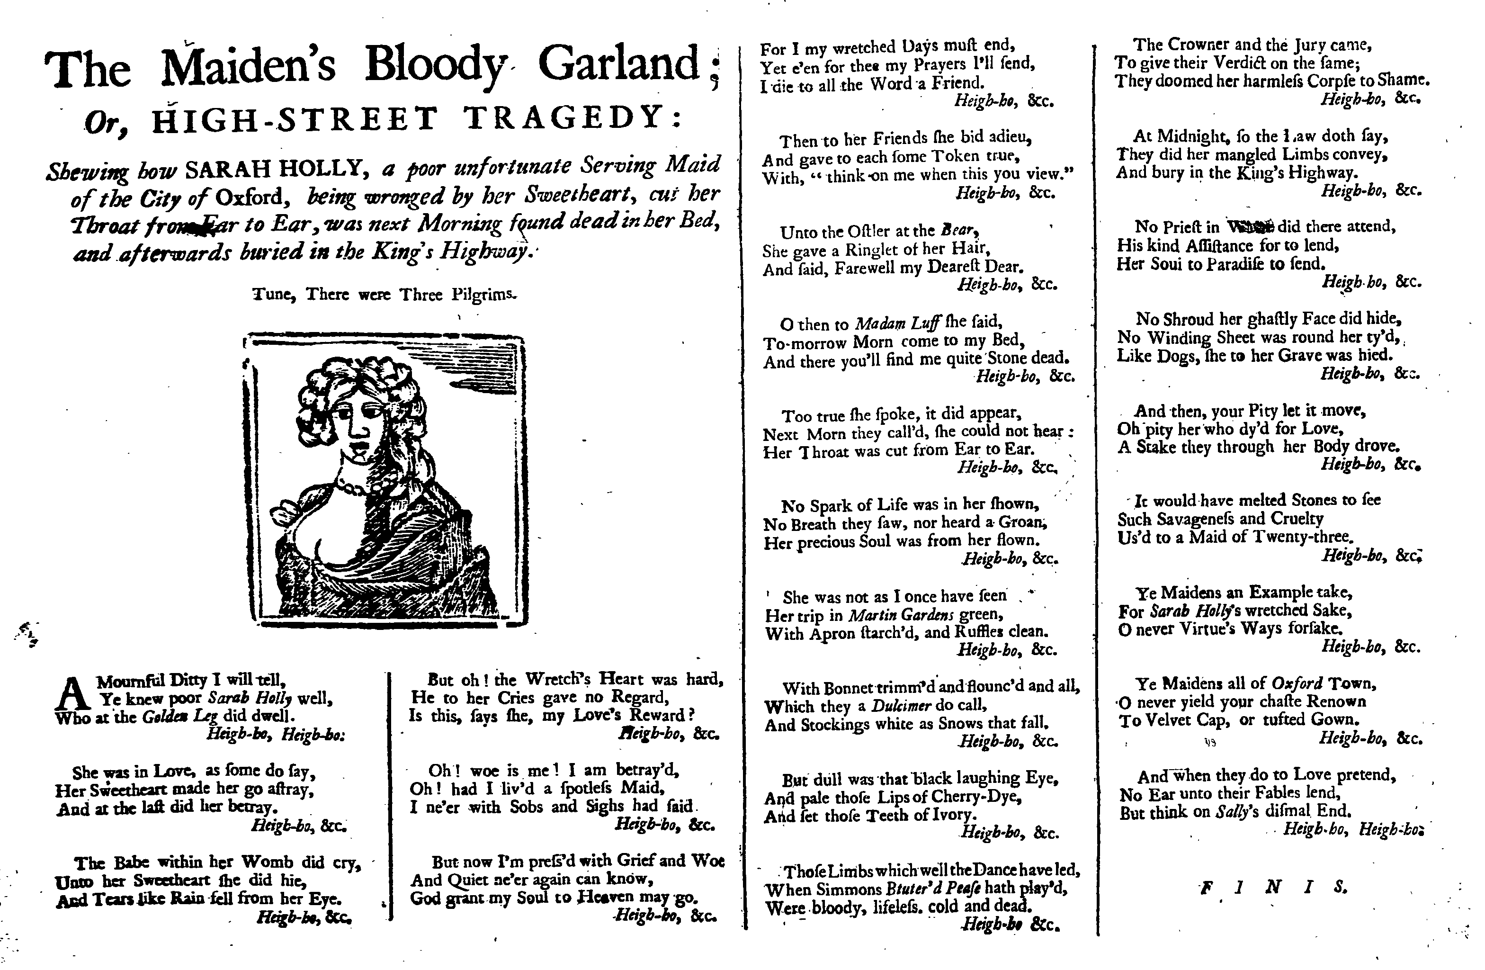
Page Images
Notes:
Some were great
most were not
Noisy
Skewed
Warped
Or they posed challenges for OCR engines
Multiple pages per image
Multiple columns
Images & decorative elements
Marginalia
Missing margins
many were terrible

Slide 12
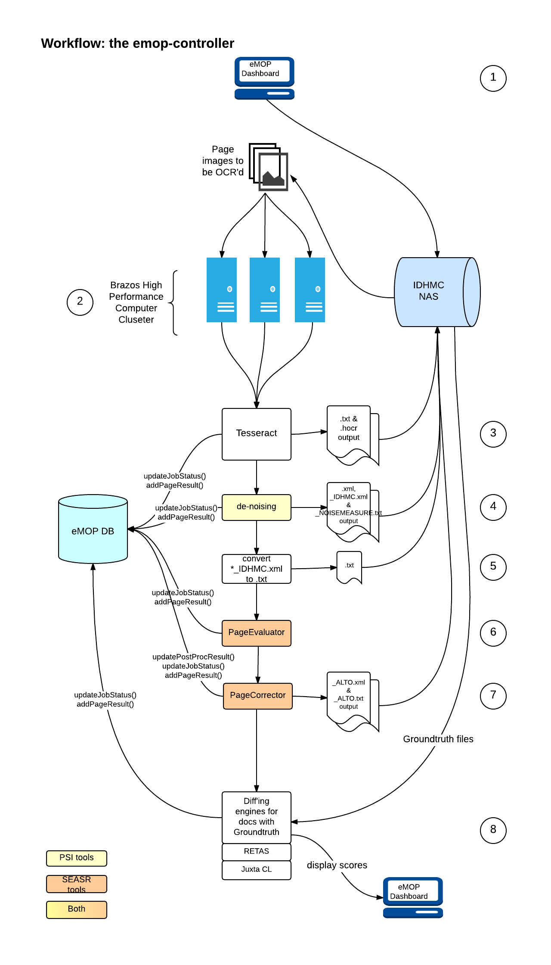
eMOP – Workflow
Page image pre-processing
Tesseract Training
deNoising

Slide 13
eMOP – Pre-processing
Original
Binarized
De-noised

Slide 14
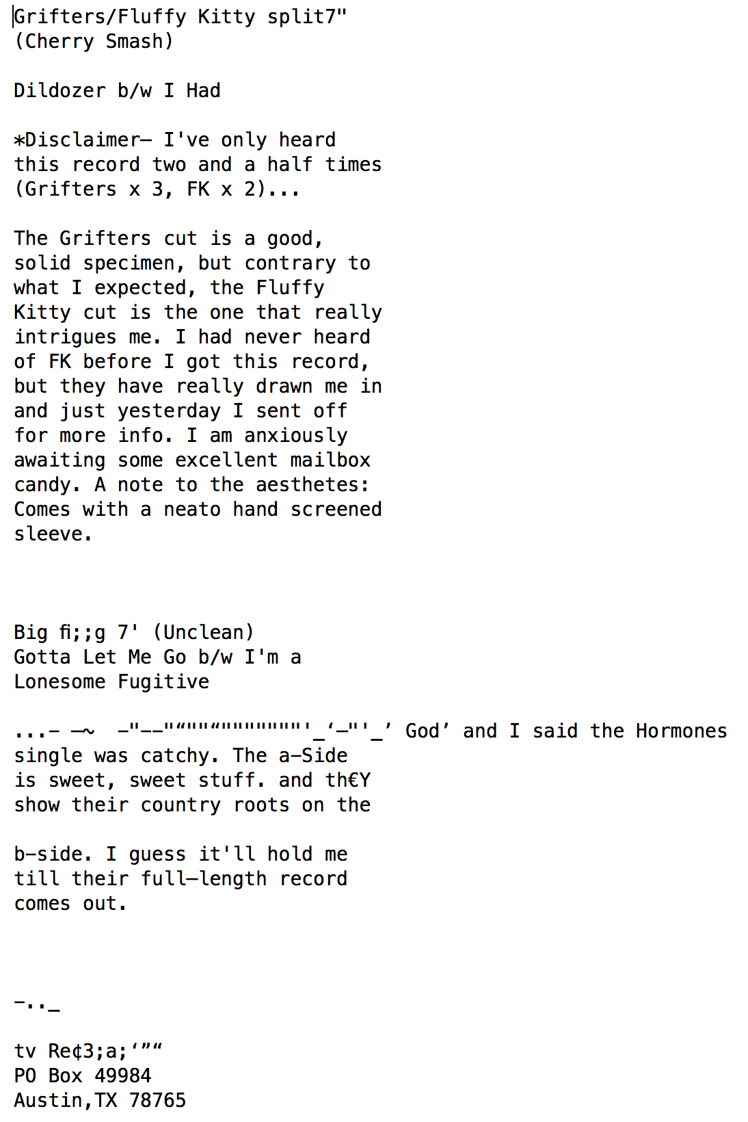
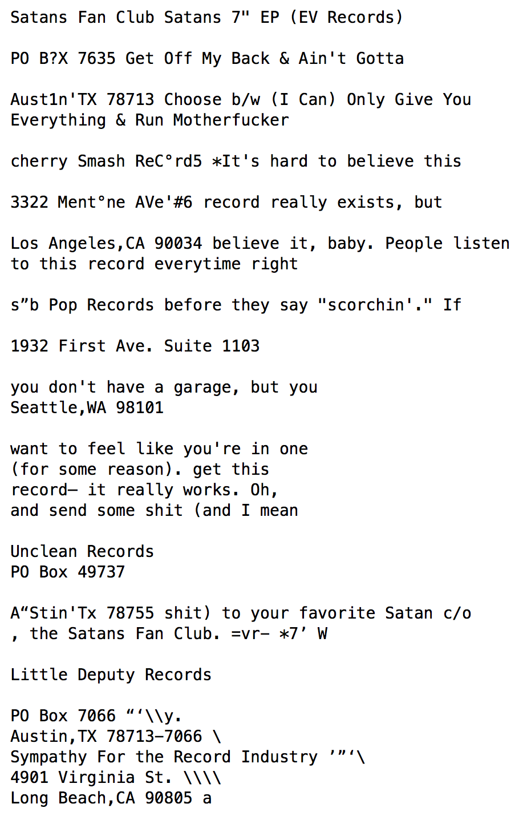
AFP - Results
Geek Weekly #3
  9 pages of GroundTruth for typed pages
  63.9% correct on all 9 pages
  94.2% correct on 6 pages
Analysis of what didn’t work
  Handwriting
  Page 10 was printed in an unusual italic typeface
    could create training – eMOP
  Pages 24 & 25 had good text recognition, but wrong reading order
  Can put in FromThePage
Page 10

Slide 15
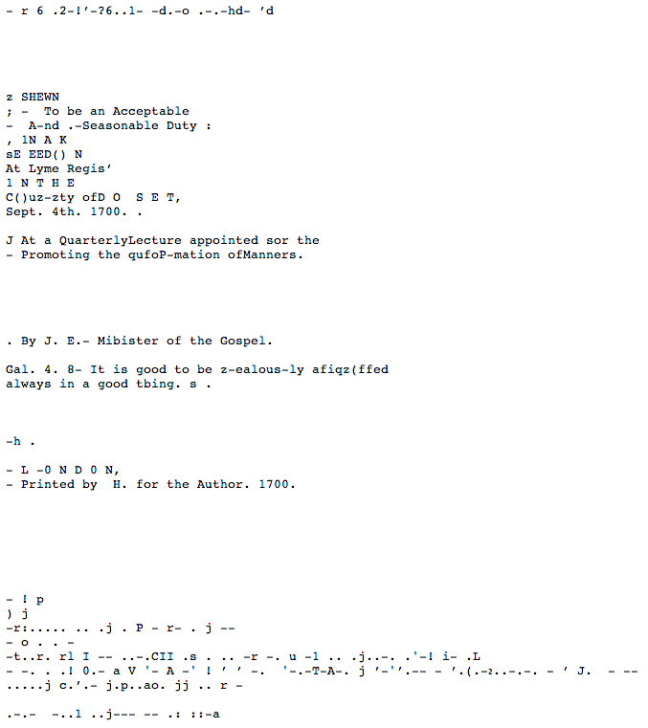
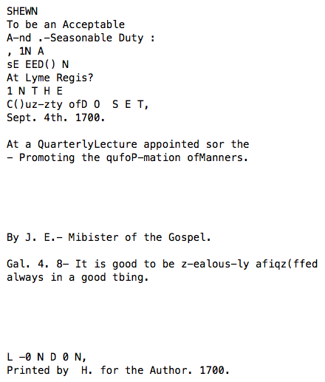
eMOP – De-noising
Before: 35%
After: 58%

Slide 16
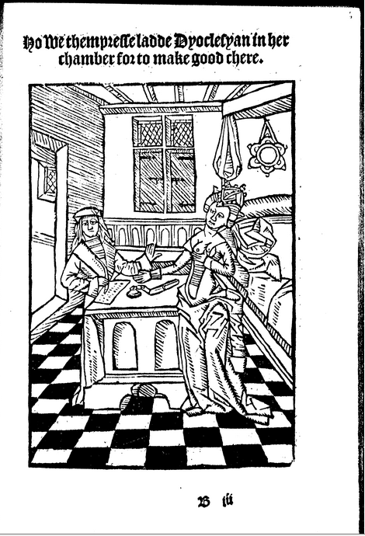
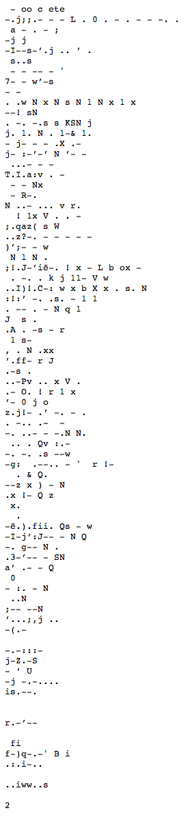

eMOP – De-noising
Before
After
Notes:
Before: 55%
After: 73%

Slide 17
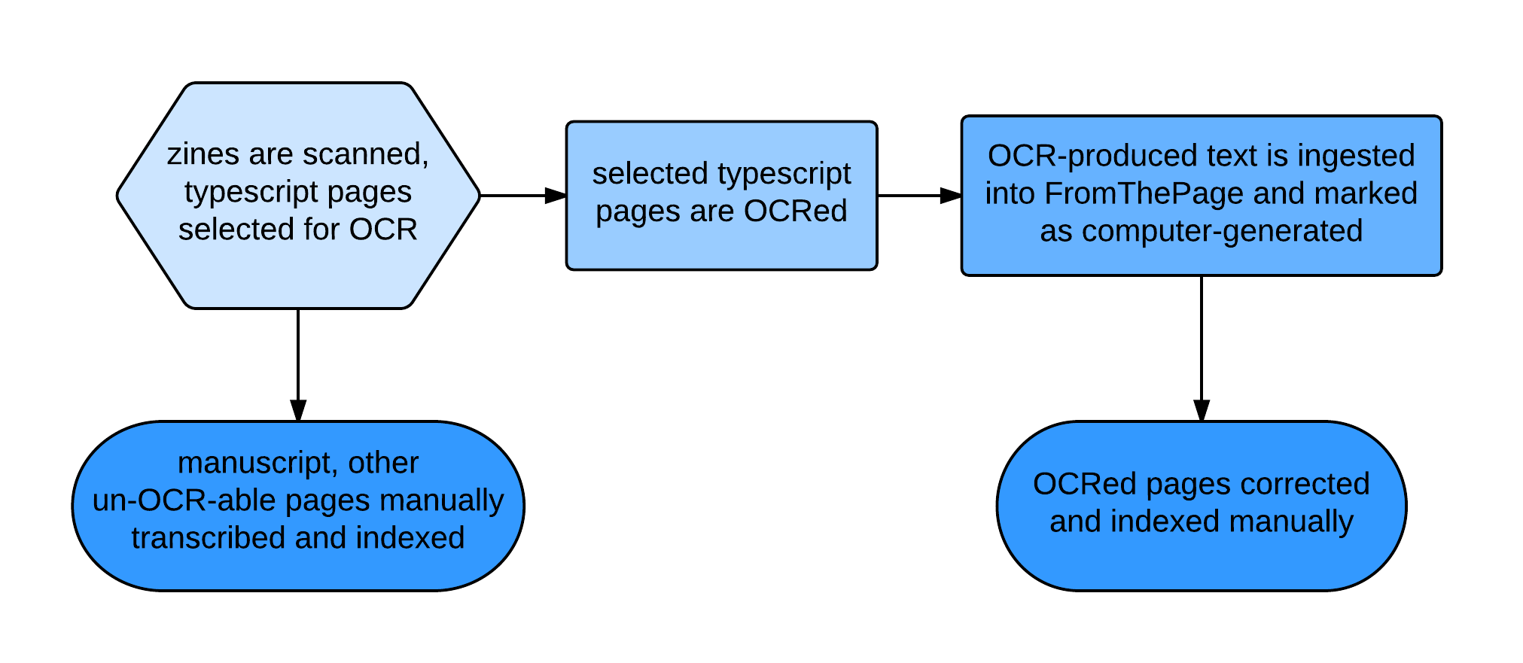
Integrating eMOP
From the Page: new status designation will be added
Launch refocused transcription effort this summer

Slide 18
Possible Applications
other collections of print ephemera with messy layout like posters, flyers, handbills, ticket stubs, track listings, liner notes, other publications
DH coursework, public engagement

Slide 19
More information:
eMOP
  emop.tamu.edu/
Austin Fanzine Project
  www.AustinFanzineProject.org
  www.facebook.com/AustinFanzineProject
  @ATXFanzineProj
  AFDTIP@gmail.com
“Why We’re Not Digitizing Zines,” Kelly Wooten, 2009, http://blogs.library.duke.edu/digital-collections/2009/09/21/why-were-not-digitizing-zines/

